Slide 1
1-Hz-CPU
Suchir Kavi, Victor Kolcan, Mesa Perry

Slide 2
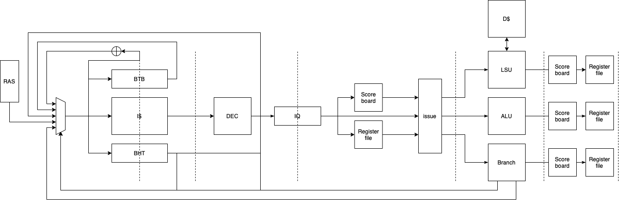
DataPath
Notes:
Victor

Slide 3


Slide 4
Pipelined Data and Instruction Cache
Benefits:
Max throughput increase over stateful cache
  Reads: once per 2 cycles -> once per cycle
  Writes: once per 3 cycles -> once per 2 cycles
  Is achieved with successive hits
Increased Fmax from 143MHz to 185Mhz – 29% speedup
Cons:
Implementation difficulty
Notes:
Mesa

Slide 5
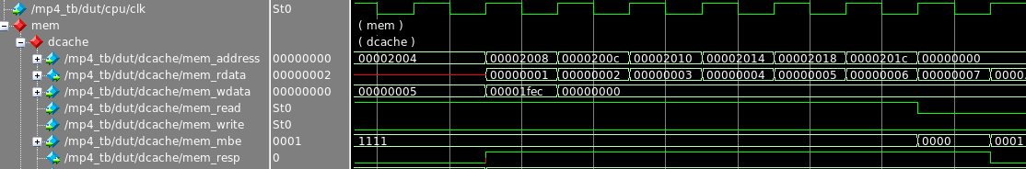
Pipeline Cache Read Max Throughput
Notes:
Mesa

Slide 6


GShare
Benefits: it’s a branch predictor
Fairly simple to implement.
Cons: i think the branch history was too long
Took too many loops to settle
Notes:
Suchir

Slide 7
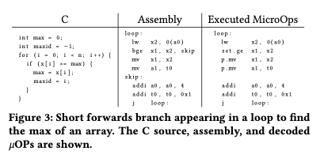
Short forward optimization
generalized cmov type operations.
Reduce comp1 to 75413 cycles.
Very little impact for other benches
Not worth it vs fmax drop.

Slide 8
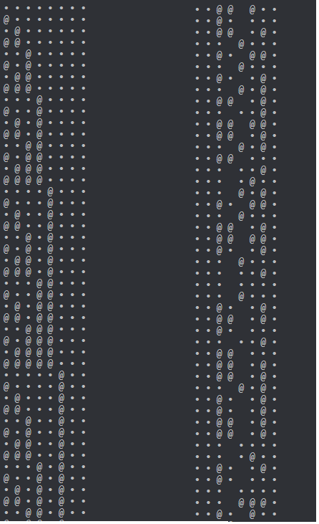
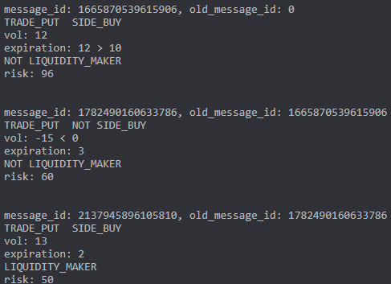
comp1b -> <- comp3b ->

Slide 9
Gshare performance
 | comp1 | comp2 | comp3
# branches | 9391 | 26487 | 2344
# taken branches | 3538 | 14731 | 1730
# not taken branches | 5853 | 11756 | 614
# mispredicts | 2360 | 3101 | 667
# taken mispredicts | 882 | 1699 | 140
# not taken mispredicts | 1478 | 1402 | 527

Slide 10
Performance
@ 185 MHz Fmax | comp1 | comp2 | comp3
# cycles | 79719 | 149093 | 113290
power | 594.12mW | 594.12mW | 594.12mW

Slide 11


Slide 12
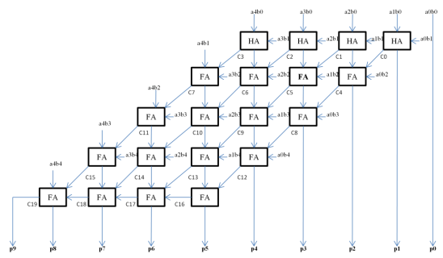
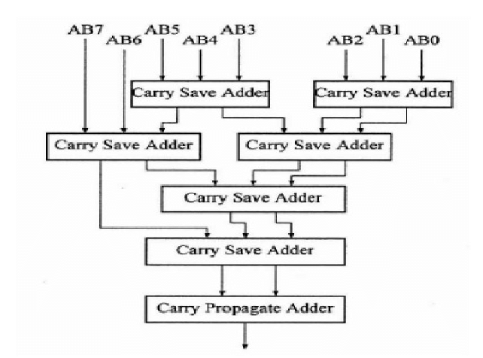
Multiplier
Multiplier helps reduce total instruction count
Sought out advanced designs such as Array, Dadda or Wallace multiplier
Went with Array because of simpler design even if it was slower
Did not finish integrating with overall CPU design
(Array Multiplier) (Wallace Multiplier)
Notes:
Victor

Slide 13

Zbb extension (Bit Manipulation)
Particularly interested in Bit Reversal part of Zbb
Wanted to use for competition codes in order to change the endianness of data
Again similar to multiply in the fact that we wanted it to reduce instructions for the competition codes
Notes:
Soooch

Slide 14
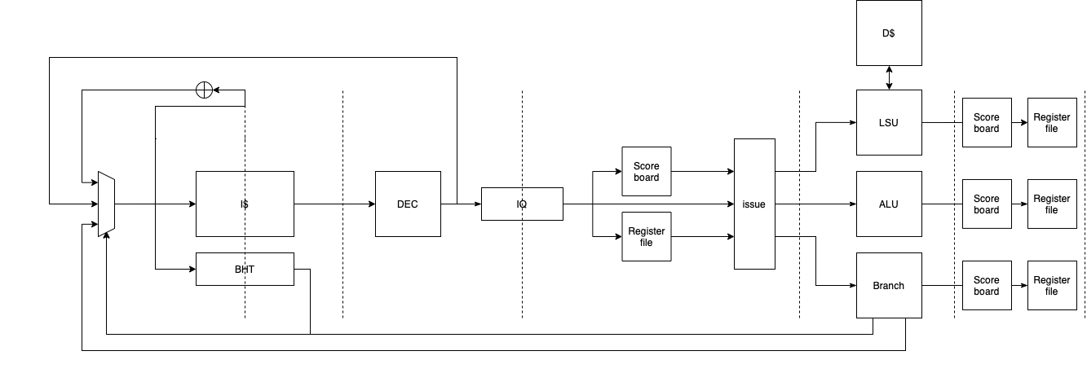
Superscalar
Scoreboard Implemented
Original Goal was a 2-way issue design
Goal was later abandoned in lieu of other design features
Superscalar was much more ambitious than we intended and we fell too far behind in the timeline to continue
Notes:
Sooch

Slide 15
Design Methodology
Based our design around the competition codes
We analyzed the instructions in each assembly file to see what each comp code targeted
Then we picked other advanced design options that would definitely increase our performance on the competition codes.
Notes:
Victor

Slide 16
Challenges Faced
Getting RVFI hooked up. Should have done this earlier. Saved a lot of time for checkpoints 3 and 4 with debugging
Managing write-back policy with a stateless cache
Jump logic correctness
Timeline issues. Took a lot longer to debug than we usually expected.
Longest Critical Path from Cache
Notes:
Mesa

